Slide 1
Word Wealth Unit 1
Verbs and Nouns

Slide 2
Verbs

Slide 3
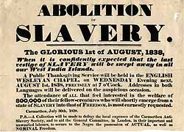
Abolish
To do away with, put an end to
Related Words
Dissipate-(energy, a mist)
Annul- (a law or marriage)
Eradicate- (a pest or evil)

Slide 4
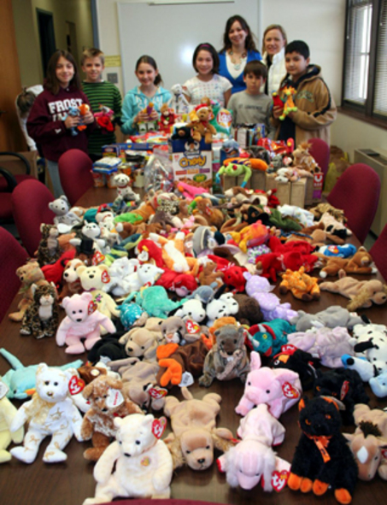
Acquire
To get, procure, obtain
Money
Reputation

Slide 5
Adapt
To make suitable, agreeable, harmonious

Slide 6
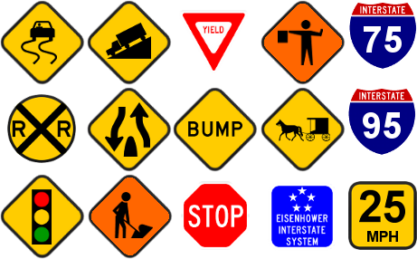
Admonish
To warn, reprove, advise
Related Word:
Forebode- (indicate beforehand or predict, usually something evil)

Slide 7
Affirm
To declare, assert
Related Words:
Warrant- (to warrant an action or idea is to justify it)
Advocate- (to advocate an idea or action is to advise or urge it)
Ant: deny, negate, disavow, repudiate

Slide 8
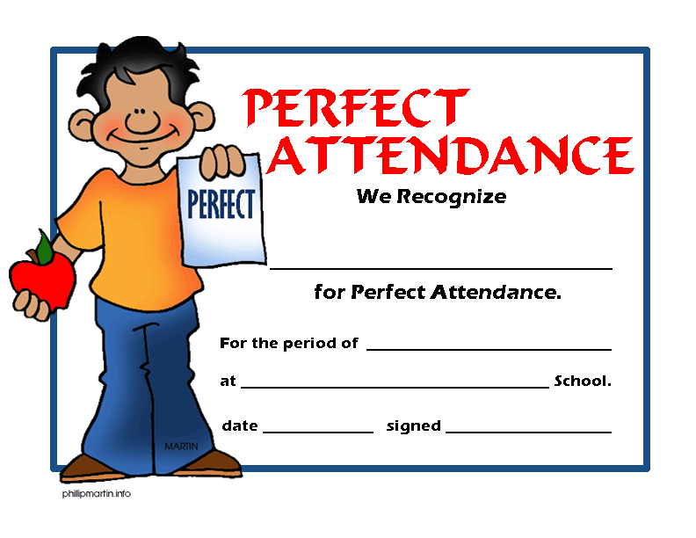
Coerce
To compel, bring about by force
Related Words:
Compulsory- (required)

Slide 9
Curtail
To cut down, reduce
Related Words:
Abbreviate- (shorten)
Abridge- (to shorten or condense a piece of work)
Ant- lengthen, amplify, expand

Slide 10
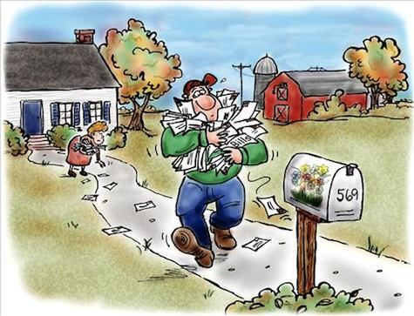
Defer
To delay or postpone
Related Word:
Deference- (to show respect to)

Slide 11
Divulge
To disclose or reveal
Related Words:
Exposure/expose- (often a scandalous disclosure)
Revelation- ( a mystery or a secret is opened up or revealed)

Slide 12
Implore
To beg, plead, entreat
Related Words:
Solicit- (ask for funds, goods, business)
Entreat- (beg for mercy)
Supplicate- (beg in prayer)
Importune- (beg in urgent need)

Slide 13
Nouns

Slide 14
Ambush
A lying in wait, or a hiding place for attack

Slide 15
Contour
Outline or profile

Slide 16
Guile
Deceit, trickery

Slide 17
Jargon
Lingo, technical language
Related Words:
Gobbledygook- (the language of government publications)
Vernacular- (common language people use every day)
Gibberish- (nonsense)

Slide 18
Labyrinth
A maze, complicated network or problem

Slide 19
Medley
A mixture or jumble
Related Word:
Heterogeneous- (collection composed of dissimilar elements)
Miscellaneous- (assortment of different items)

Slide 20
Rapture
Ecstasy, thrills, keen delight
Related Words:
Relish- (you relish the moment)
Entranced- (spellbound)
Enthralled- (captivated)

Slide 21
Robot
A mechanical creature, an automaton

Slide 22
Verge
Edge or border

Slide 23
Zephyr
A gentle breeze

