Slide 1
Word Wealth 1,8
VERBS AND ADJECTIVES

Slide 2
Verbs

Slide 3
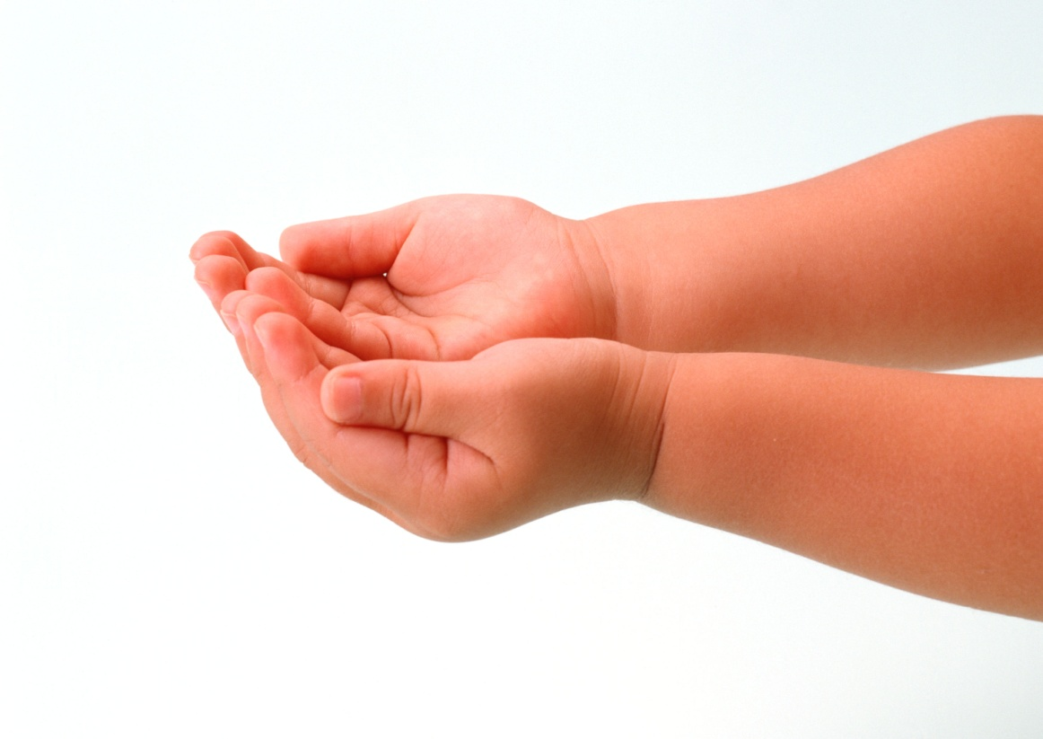
Impute – attribute or ascribe (to another)

Slide 4
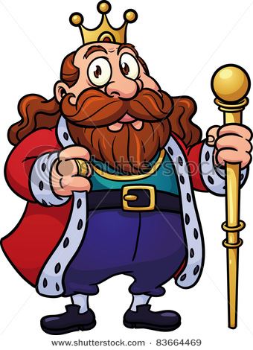
Renounce – give up, cast off, deny a claim (formally)
Relinquish – give up, abandon, let something go
Forgo – deny oneself a privilege or right
Abdicate – give up a post or responsibility
Waive – put aside, forgo a claim or right, withhold

Slide 5
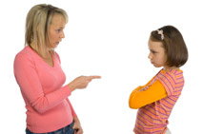
Reprimand – to rebuke formally or severely
Reproof – mild rebuke
Censure – strong, formal criticism
Expostulation – reason earnestly

Slide 6
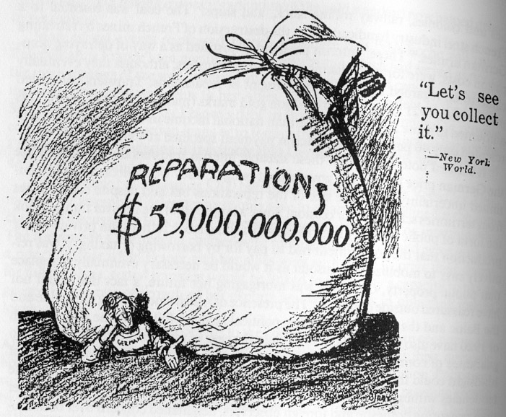
Requite – to repay, reward
Reparation – repair or pay for damage done
Restitution – restore, compensate, or make amends for injury or damage one has done

Slide 7
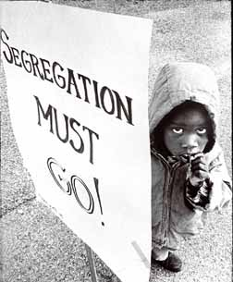
Segregate – to separate, set apart

Slide 8
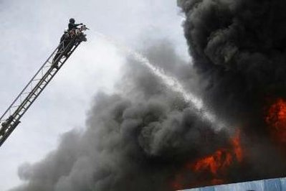
Subjugate – to bring under control, subdue
Vanquish – resounding way to conquer

Slide 9
Surmount – to rise above, overcome

Slide 10
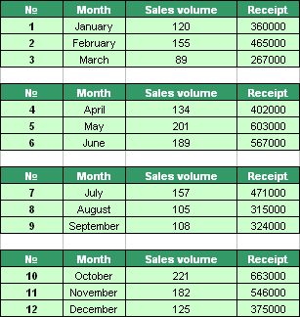
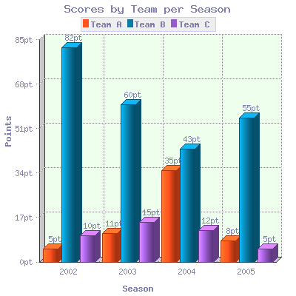
Tabulate – to organize (data) in tables and columns

Slide 11
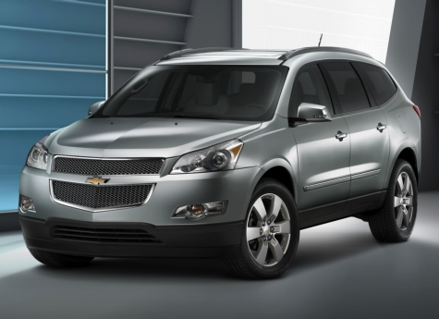
Traverse – to move across or pass over

Slide 12
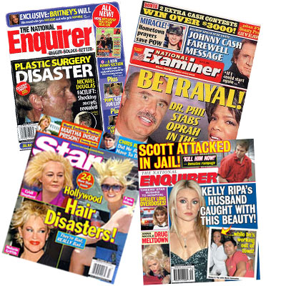
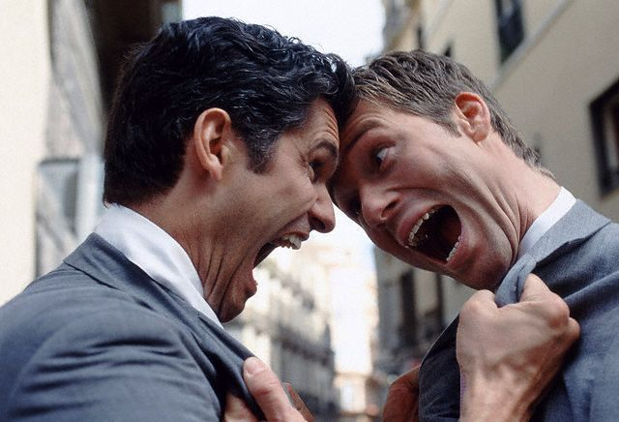
Vilify – to speak evil of, defame
Revile – abuse or defame
Defame/Defamation – distributing information damaging to a person’s reputation

Slide 13
ADJECTIVES

Slide 14
Intricate – complicated, complex

Slide 15
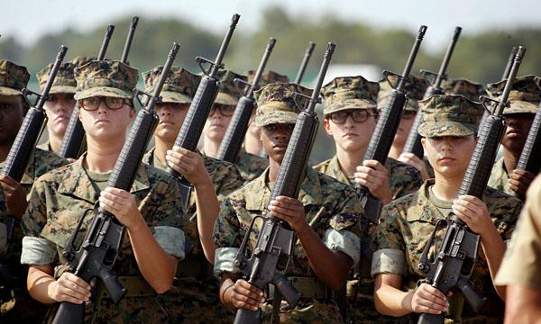
Martial – warlike, military

Slide 16
Negligible – trifling, unimportant

Slide 17
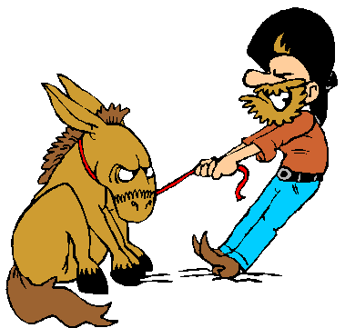
Obstinate – stubborn, dogged, not easily subdued
Tenacity – the will to hang on, will power
Doggedness – stubborn adherence to a plan or goal
Perseverance – stick-to-it-iveness, endurance
Resoluteness – strong determination

Slide 18
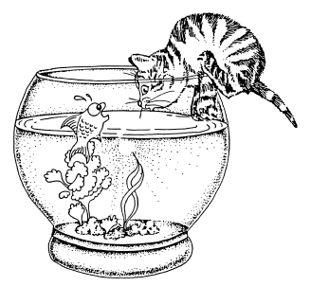
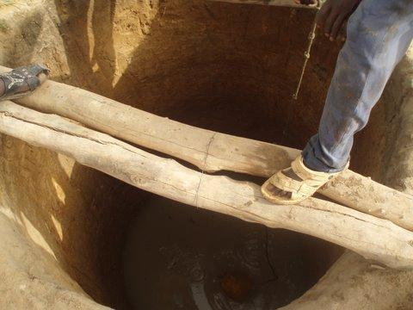
Precarious – insecure, uncertain

Slide 19
Redundant – repetitious, unnecessary to the meaning

Slide 20
Requisite – necessary, indispensable

Slide 21
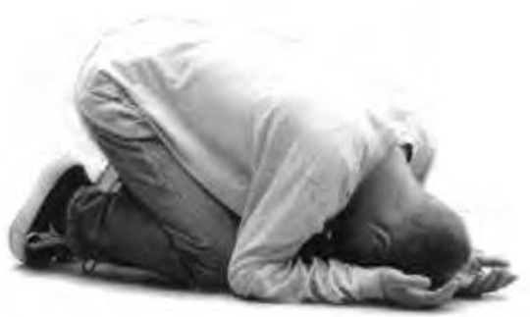
Servile – yielding, submissive, befitting low position
Menial – humble, lowly, usually disagreeable
Subservient – adapts readily to the wishes and authority of another

Slide 22
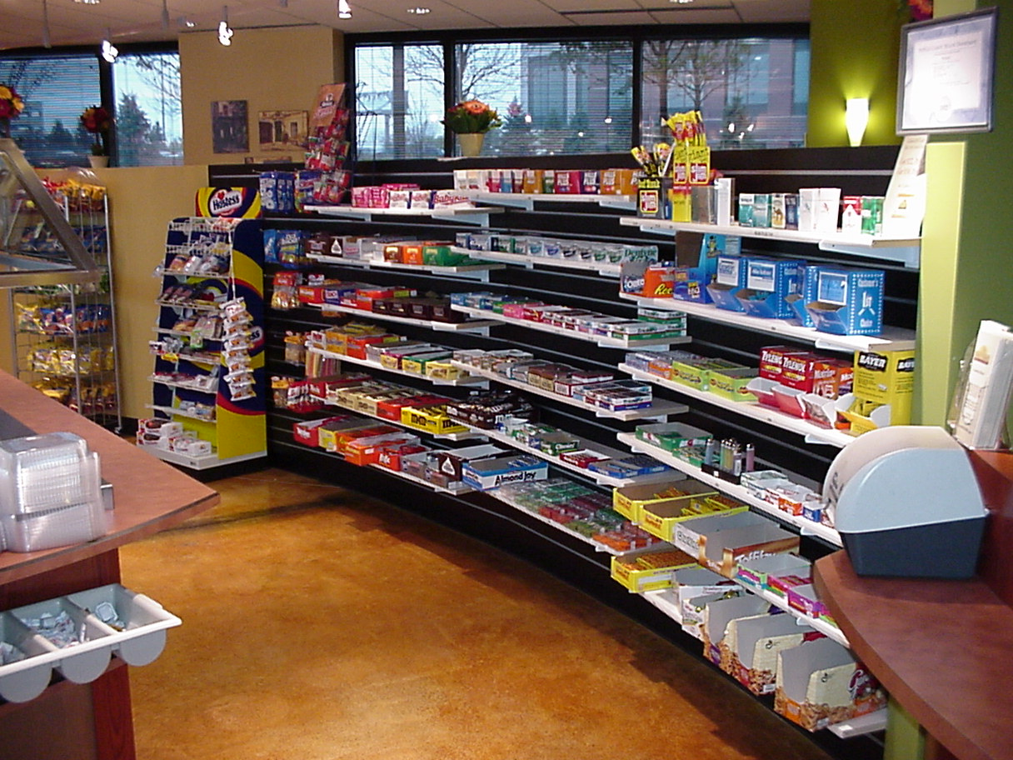
Sundry – various, assorted, diverse

Slide 23
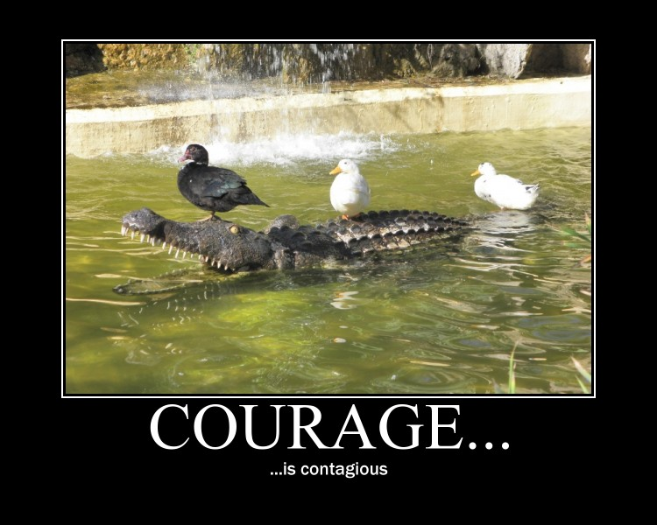
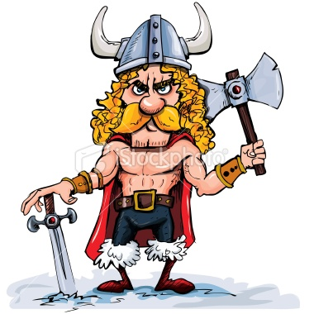
Valiant – brave, courageous
Gallant – plucky, staunch, brave
Intrepid – fearless, daring, skillful

