Slide 1
VOCABULARY UNIT 7
Level F

Slide 2
AUSTERE
AUSTERE: (adj) severe or stern in manner; without adornment or luxury, simple, plain; harsh or sour in flavor
Synonyms: forbidding, rigorous, puritanical, ascetic, anadorned, subdued
Antonyms: mild, indulgent, luxurious, flamboyant

Slide 3
BENEFICENT
BENEFICENT: (adj) performing acts of kindness or charity; conferring benefits, doing good
Synonyms: humanitarian, magnanimous, charitable
Antonyms: selfish, cruel, harmful, deleterious

Slide 4
CADAVEROUS
CADAVEROUS: (adj) pale, gaunt, resembling a corpse
Synonyms: corpselike, wasted, haggard, emaciated, ghastly
Antonyms: robust, portly, rosy, the picture of health

Slide 5
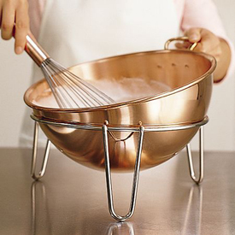
CONCOCT
CONCOCT: (v) to prepare by combining ingredients, make up (as a dish); to devise invent, fabricate
Synonyms: create, fashion, rustle up

Slide 6
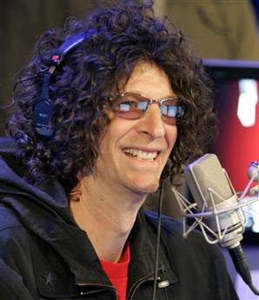
CRASS
CRASS: (adj) coarse, unfeeling; stupid
Synonyms: crude, vulgar, tasteless, oafish, obtuse
Antonyms: refined, elegant, tasteful, polished, brillant

Slide 7
DEBASE
DEBASE: (v) to lower in character, quality, or value; to degrade, adulterate; to cause to deteriorate
Synonyms: cheapen, corrupt, demean, depreciate
Antonyms: elevate, uplift, improve, enhance

Slide 8
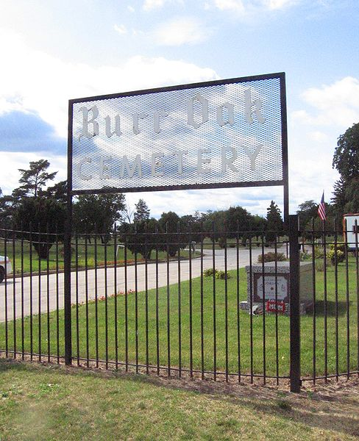
DESECRATE
DESECRATE: (v) to commit sacrilege upon, treat irreverently; to contaminate, pollute
Synonyms: profane, defile, violate
Antonyms: revere, honor, venerate, consecrate

Slide 9
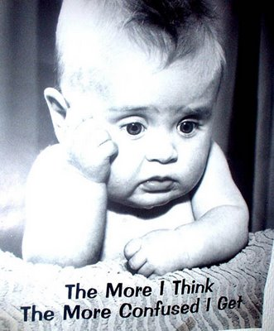
DISCONCERT
DISCONCERT: (v) to confuse; to disturb the composure of
Synonyms: upset, rattle, ruffle, faze, perturb
Antonyms: relax, calm, put at ease

Slide 10
GRANDIOSE
GRANDIOSE: (adj) grand in an impressive or stately way; marked by pompous affectation or grandeur, absurdly exaggerated
Synonyms: majestic, bombastic, highfalutin
Antonyms: simple, modest, unaffected, humble

Slide 11
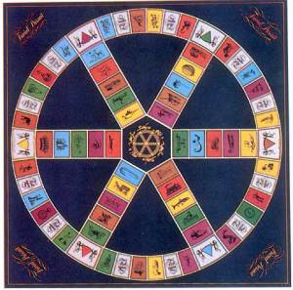
INCONSEQUENTIAL
INCONSEQUENTIAL: (adj) trifling, unimportant
Synonyms: trivial, negligible, petty, paltry
Antonyms: important, essential, crucial, vital

Slide 12
INFRACTION
INFRACTION: (n) a breaking of a law or obligation
Synonyms: violation, transgression, breach, offense

Slide 13
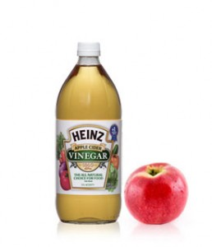
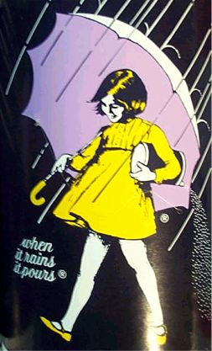
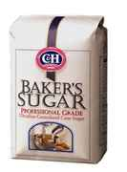
MITIGATE
MITIGATE: (v) to make milder or soften, to moderate in force or intensity
Synonyms: lessen, relieve, alleviate, diminish
Antonyms: aggravate, intensify, irritate, exacerbate

Slide 14
PILLAGE
PILLAGE: (v) to rob of goods by open force (as in war), plunder; (n) the act of looting; booty
Synonyms: ravage, sack, loot

Slide 15
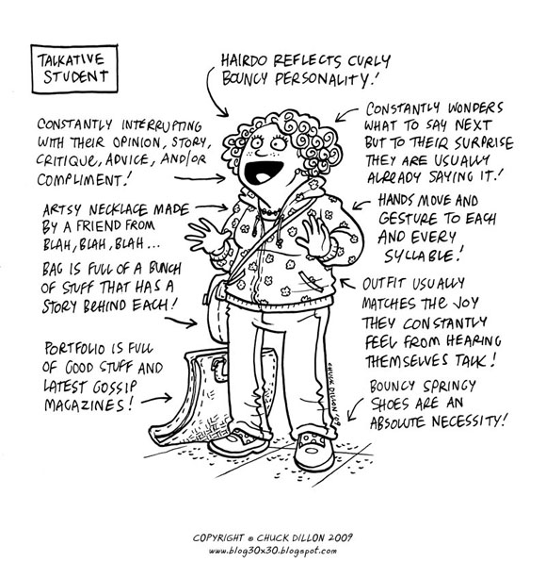
PRATE
PRATE: (v) to talk a great deal in a foolish or aimless fashion
Synonyms: chatter, prattle, blab, blabber, palaver
Antonyms: come to the point, not waste words

Slide 16
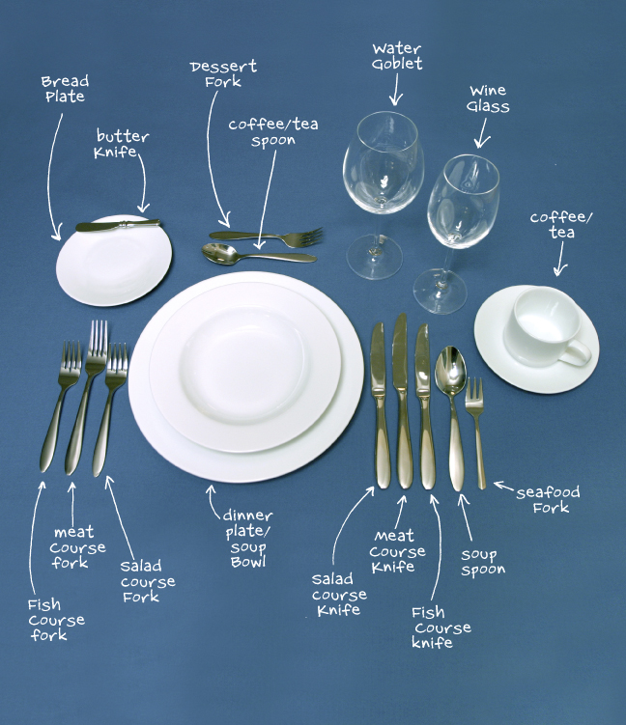
PUNCTILIOUS
PUNCTILIOUS: (adj) very careful and exact, attentive to fine points of etiquette or propriety
Synonyms: precise, scrupulous, exacting, fussy, finicky
Anotnyms: careless, negligent, lax, perfunctory

Slide 17
REDOUBTABLE
REDOUBTABLE: (adj) inspiring fear or awe; illustrious; eminent
Synonyms: formidable, fearsome, awesome, august
Antonyms: laughable, risible, contemptible

Slide 18
REPROVE
REPROVE: (v) to find fault with, scold, rebuke
Synonyms: chide, chastise, upbraid, reporach
Antonyms: praise, commend, laud, pat on the back

Slide 19
RESTITUTION
RESTITUTION: (n) the act of restoring someone or something to the rightful owner or to a former state or position; making good on a loss or damage
Synonyms: compensation, reimbursement, redress, restoration

Slide 20
STALWART
STALWART: (adj) strong and sturdy; brave; resolute (n) a brave, strong person; a strong supporter; one who takes an uncompromising position
Synonyms: sturdy, stout, intrepid, valiant, mainstay
Antonyms: weak, infirm, irresolute, vacillating

Slide 21
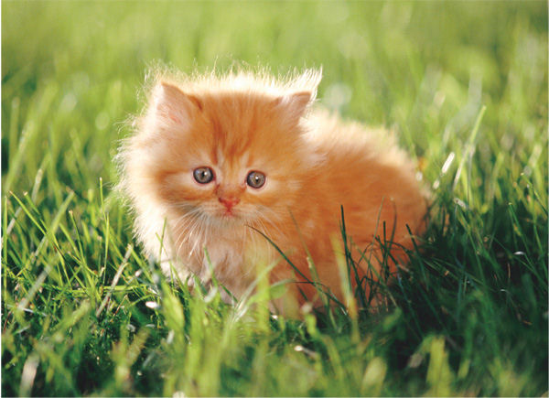
VULNERABLE
VULNERABLE: (adj) open to attack; capable of being wounded or damaged; unprotected
Synonyms: defenseless, exposed, unguarded
Antonyms: invincible, protected, safe, secure

